Slide 1


Slide 2
INOVATIONS IN UNDERGROUND MINING METHODS AND TECHNOLOGY FOR WINNING METALLIFEROUS DEPOSITS

Slide 3
INTRODUCTION
The investors have been encouraged in the mining sector to enhance the expenditure on exploration and exploitation of minerals
    Increase in the metal prices
    Increase in demand of minerals
has brought boom in Indian Mining Industry.

Slide 4
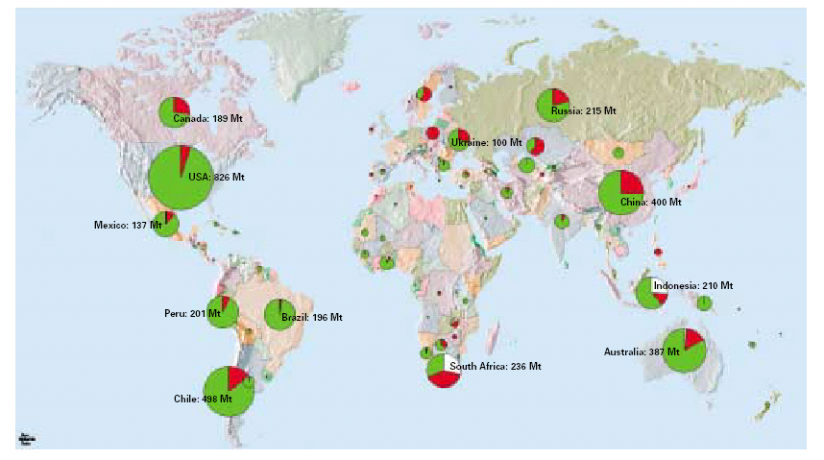
Ore production from open pit (green), underground (red) and alluvial/recycling (white)
India

Slide 5
Underground mining is a dusty, noisy, and dangerous work.
New innovative technologies have been introduced to reduce the risk associated with mining and ore transport
Some of these innovations are presented in this paper.

Slide 6
ACCESS TO THE ORE BODY
General trend of opening an underground metalliferous deposit is by vertical shaft accompanied by a decline or ramp.
The vertical shaft is used for hoisting the ore, while
decline is used for providing service to the mine using trackless tyre mounted vehicles.
Decline or ramp facilitates quick access to the ore body and early production of ore.

Slide 7
Cannington Silver and Lead mine, Queensland, Australia accessed the underground ore body via a 5,250 m long 5.2 m high and 5.5 m wide decline.
a vertical hoisting shaft with finished internal diameter of 5.6m was constructed from the surface to 650m for ore hoisting

Slide 8
The Target ore bodies at 2,200-2,500m depth below surface in Target Gold mine, South Africa, have been accessed by declines sunk from the existing underground infrastructure.
The declines are equipped with roof-slung Walter-Becker monorails for transporting materials from the Loraine shaft to the Target mine production areas.

Slide 9
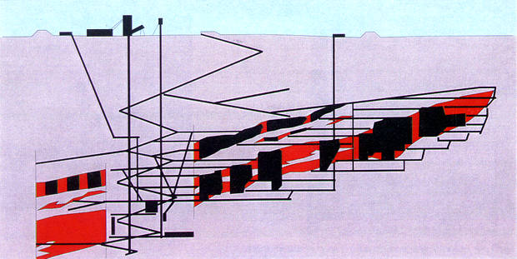
Cross-section through the Tara orebody,
showing the mine infrastructure

Slide 10
Atlascopco Box drill.ppt
,writh raise boring.ppt
Wirth shaft boring.ppt
Raise borers are widely used for making raises. Some of the mines using raise boring machines are:
  Obuasi Gold Mine, Ghana ;
  Kiruna Iron ore mine Sweden;
  George Fisher Lead-Zinc and Silver mine Queensland, Australia;
  Norilsk Mining Centre’s Nickel, Palladium and Copper Production Facility, Russia;
  Stillwater/East Boulder Platinum and Palladium Mines, USA and
  Brunswick Lead and Zinc mine, New Brunswick, Canada

Slide 11
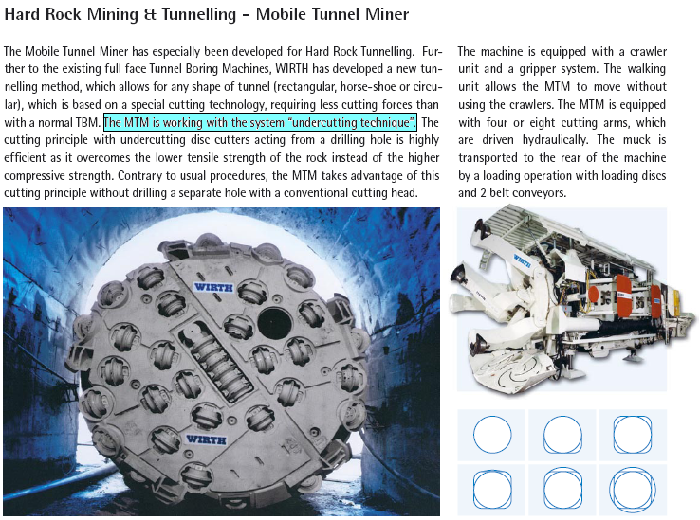
Wirth Undercutting Technology.ppt

Slide 12
UNDERGROUND ORE HAULAGE AND HOISTING
General trend is towards fully automatic underground ore haulage and hoisting system
Once the ore is dumped into the ore passes, the rest of the operations i.e. collection of the ore from the ore passes, dumping into an ore bin, primary crushing, loading the crushed ore to a skip and hoisting are fully automatic and man-less.
Technological development is on the way for fully automatic loading by LHD, grade wise sorting and dumping into ore-passes.
The underground mines are equipped with underground vehicle management and communication system.

Slide 13
Kiruna Underground Iron Mine of LKAB, Sweden is having ore handling system, which can now handle 26 Mt/year.
The phosphorus content of ore in LHD buckets is measured in real time using Laser Induced Florescence (LIF). Accordingly, they are sorted to ore passes designed for certain quality.

Slide 14
Finch Diamond Mine, South Africa is using underground vehicle management and communication system since 1988,
  the system upgraded to an EL-Equip Multicom radio-controlled data transfer system based on leaking feeder technology. The system permits multi channel voice and data transmission.
  The position of LHDs underground is monitored using Modular Mining and dispatch system,
  the controller on surface instructing the individual machines where to load and dump through the mine wide communication net work.
Similar type of system has been installed in Target Gold mine, South Africa and Rocanville Potash mine, Canada.

Slide 15
Mount Isa Lead mine, Queensland, Australia uses Micromine mine control system for controlling the rail system for dumping ore and waste to crushing station at the base of hoisting shaft and hoisting the crushed waste and ore to surface.
This mine has also invested in flexible mobile equipments and introduced tele-remote ore loading

Slide 16
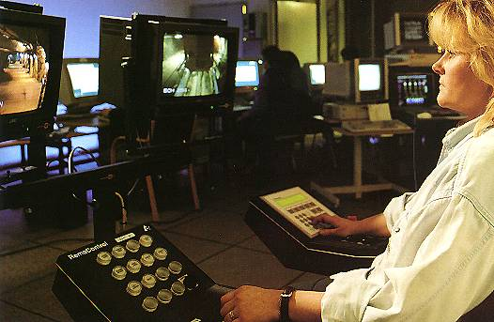
Remote Control of Trains on the 1045m level from the control centre on the 775m level in Kiruna UG Iron Ore mine, Sweden

Slide 17
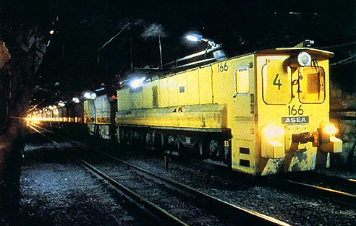
Automatic locomotive at Kiruna UG Iron Ore mine, Sweden

Slide 18
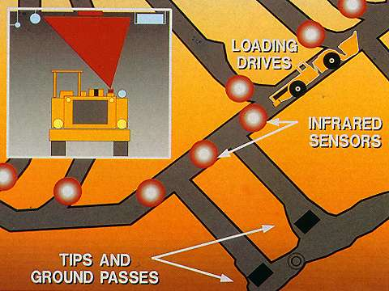
Schematic layout of Vehicle Despatch at Finsch Diamond mine, South Africa

Slide 19
METHODS OF WORKING
The most widely used method is Long Hole Open Stoping with backfill.
The mines using Cut and Fill method have switched over to Long Hole Open Stoping with backfilling and subsequent recovery of pillars between two filled stopes.
The conventional Cut and Fill stopes are also converted to Bench Mining with Filling.
The Long Hole Open stoping in mines are generally highly mechanised using trackless drilling and hauling equipments using
    Holes of larger diameter
    Bulk charging with emulsion explosives.
    blast holes initiated using electronic detonators.
    Emphasis on blasting significant number of holes for breaking maximum volume of ore per blast.

Slide 20
In Kiruna mine, where sub-level caving is practised
  the sub-level interval has been increased from 12 to 27m
  blast hole diameter from 57 to 115mm
  upward blast holes of 115mm diameter are charged by pumping emulsion explosive @ 100 kg/min through a 60m long charging hose with inside diameter of 25mm.
Room and Pillar method also, has been made highly mechanised using trackless tyre mounted drilling and loading equipment in the stopes.
Manual mining is practised where the thickness of the orebody and its inclination does not permit use of mechanisation.

Slide 21
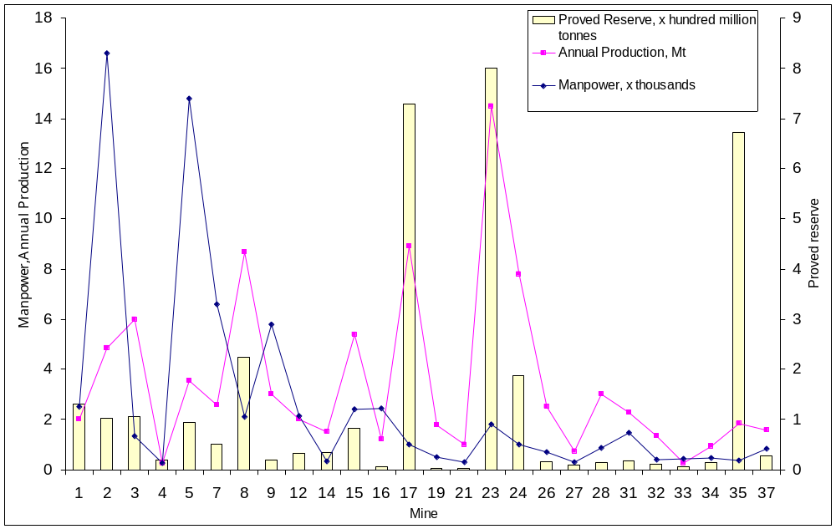
MINE RESERVES, PRODUCTION AND PRODUCTIVITY
Mine wise distribution of man power, annual production and ore reserve

Slide 22
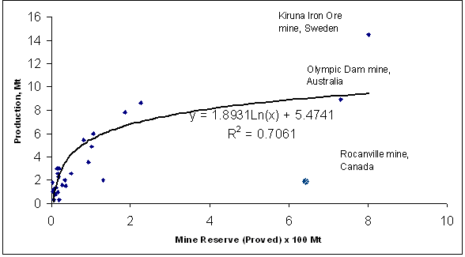
Annual production versus mine reserves

Slide 23
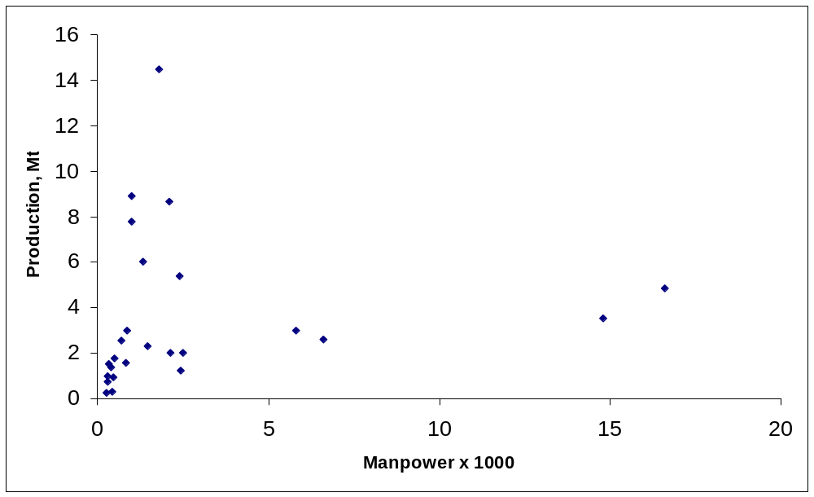
Manpower versus annual production

Slide 24
OTHER TECHNOLOGICAL INNOVATIONS IN UNDERGROUND METAL MINING
Fuel Cell Technology
  A fuel cell consists of two electrodes sandwiched around an electrolyte.
  Oxygen passes over one electrode and hydrogen over the other, generating electricity, water and heat.
  Hydrogen fuel is fed into the "anode" of the fuel cell.
  Oxygen (or air) enters the fuel cell through the cathode.
  Encouraged by a catalyst, the hydrogen atom splits into a proton and an electron, which take different paths to the cathode.
  The proton passes through the electrolyte. The electrons create a separate current that can be utilized before they return to the cathode, to be reunited with the hydrogen and oxygen in a molecule of water.
a fuel cell operates like a battery
  it does not run down or require recharging.
  It produces energy in the form of electricity and heat as long as fuel is supplied.

Slide 25
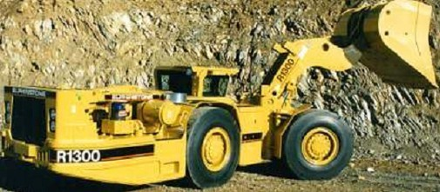
A fuel cell powered mine loader

Slide 26
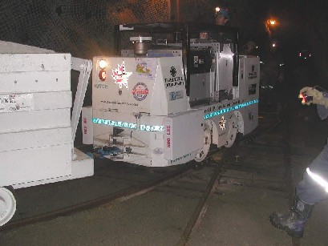
A fuel cell powered mine locomotive

Slide 27
Battery Loco vs Fuel Cell Loco
 | Battery Locomotive | Fuel cell Locomotive
Power, rated continuous | 7.1 kW (gross) | 17 kW (gross)
Current, rated continuous | 76 Amps | 135 Amps
Voltage at continuous rating | 94 Volts (estimated) | 126 Volts
Energy capacity, electrical | 43 kWh | 48 kWh
Operating time | 6 hours (available) | 8 hours
Recharge time | 8 hours (minimum) | 1 hour (maximum)
Vehicle weight | 3,600 kg | 2,500 kg (without ballast)

Slide 28
Tele/Arm Chair mining
Tele mining or the arm-chair mining means − a technology of getting miners out of the tunnels and getting into the control room
It is a semi-automated process where an operator manipulates equipment from a distance.
Guidance systems, based on optical or lasers systems are installed underground, allowing vehicles to travel through tunnels autonomously.

Slide 29
INCO teleoperates drilling equipment and LHDs at its Stobie Nickel mine.
The mine remotely operates four long-hole carbide drills from a control centre 10 miles away

Slide 30
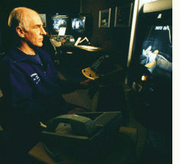
A teleoperator in an INCO control room is able to manipulate loading in a mine 10 miles away

Slide 31
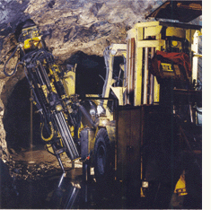
LKAB, a Swedish company, installed remote controlled drill rigs at its Kiruna mine in the 1990s.

Slide 32
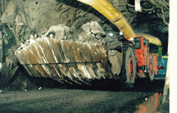
A LHD vehicle in LKAB's iron ore mine in Sweden scoops rock with the help of a teleoperator working off-site; the vehicle does hauling and dumping automatically

Slide 33
HPDI Technology: Giving new dimension of performance for diesel engines
This allows diesel engines to run primarily on natural gas with no intrusive engine modifications while reducing emissions .
accomplished through late cycle high pressure direct injection of natural gas into a diesel engine combustion chamber at the end of compression stroke. A small amount of diesel fuel is injected first to initiate combustion followed by the main natural gas fuel injection. The diesel cycle and its operating characteristics are fully retained.
This technology will reduce the cost of mine haul operations in terms of fuel cost saving as well as emission reductions.
The advantages of natural gas use among mine haul truck operations can be replicated across a broad range of engines and applications.

Slide 34
Hydraulic pre-stressing unit
A new generation of hydraulic mine support pre stressing device
These thin walled steel shells are machine welded and can be inflated with water or any liquid to provide pre stressing for a wide variety of roof support.
They can also establish roof contact eliminating the need for wooden wedges or crib blocks, commonly employed with several standing roof support products.
Capable of withstanding pressure from 1000-6000 psi
A recent development has been the addition of a yield valve that provides control of the maximum pressure and load development on the support

Slide 35
PSU can economically turn almost any passive standing support into an active support
The development of an inexpensive yield valve allows the unit to function as a yield or load control device.
This can significantly improve the capability of very stiff but brittle supports

Slide 36
Cavity Monitoring System (CMS)
This device can scan the extent of stope from a position within the cavity, giving it significant advantage over conventional survey method.
It is a main tool used by mine surveyors to survey underground stopes and other cavities.
In most of the cases, CMS is the only means of determining the extent and volume of an otherwise inaccessible underground cavity.
also used to determine the ore recovery and dilution.

Slide 37
In situ leaching of minerals
As on date, commercial leaching of minerals is being done only for some selected metals like uranium and copper.
Majority of the minerals are ordinarily not suitable for leaching.
However, the emerging application of biotechnology can help develop the chemicals that could be used for extraction of the valuable content from almost all types of minerals.
Leaching has to be the method of extraction of the minerals in future.

Slide 38
CONCLUSION
There is a lot of scope for improvement of production technology and productivity in the mines.
It has become essential because of the increasing cost of conventional mining operations.
The economic mining of minerals can sustain only by adopting the newer technologies in almost all spheres of mining.

Slide 39


